Slide 1
Weed Identification
Agronomy CDE

Slide 2
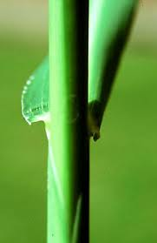
Barnyard Grass

Slide 3
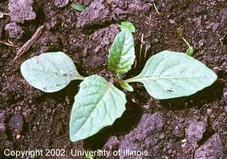
Black Nightshade

Slide 4
Broadleaf Plantain

Slide 5
Buckhorn Plantain

Slide 6
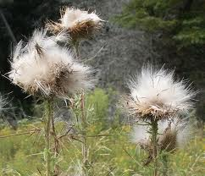
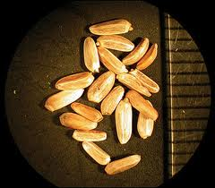
Bull Thistle

Slide 7
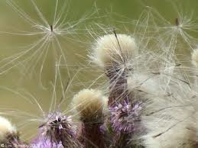
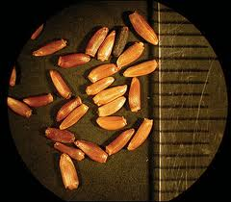
Canada Thistle

Slide 8
Cheat Grass

Slide 9
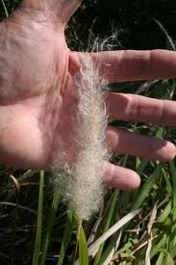
Cogongrass

Slide 10
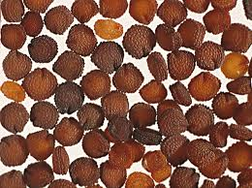
Common Chickweed

Slide 11
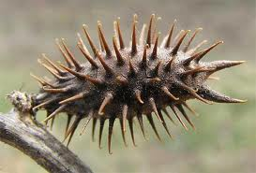
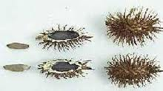
Common Cocklebur

Slide 12
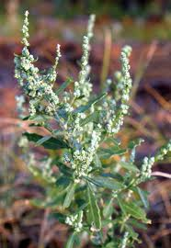
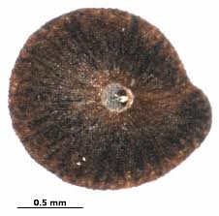
Common Lambs Quarter

Slide 13
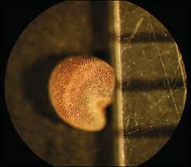
Common Mallow

Slide 14
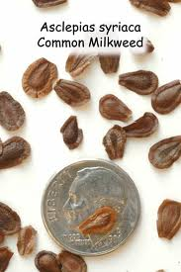
Common Milkweed

Slide 15
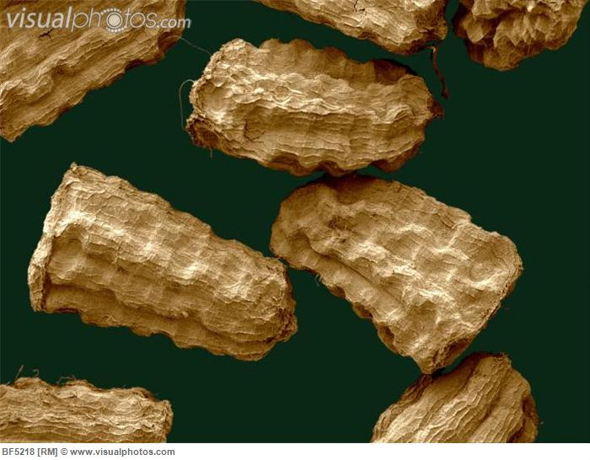
Common Mullein

Slide 16
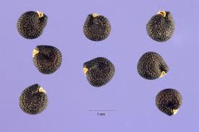
Common Purslane

Slide 17
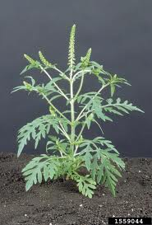
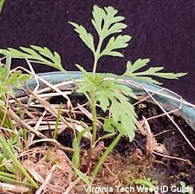
Common Ragweed

Slide 18
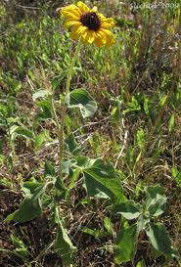
Common Sunflower

Slide 19
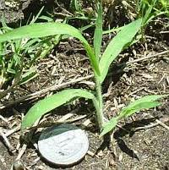
Crabgrass

Slide 20
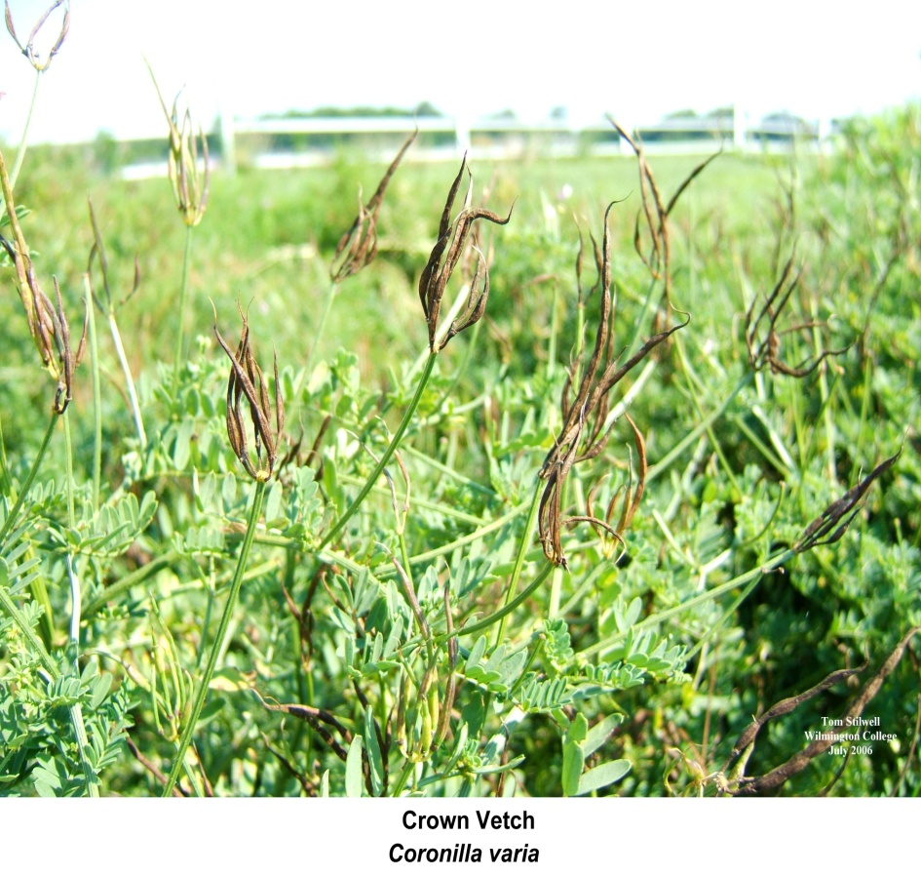
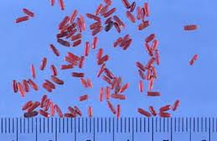
Crown Vetch

Slide 21
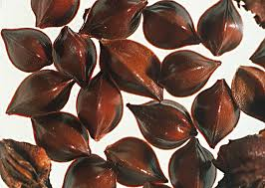
Curly Dock

Slide 22
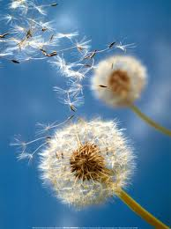
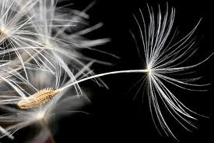
Dandelion

Slide 23
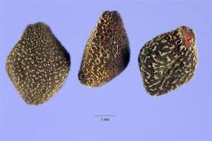
Field Bindweed

Slide 24
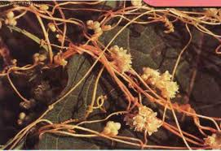
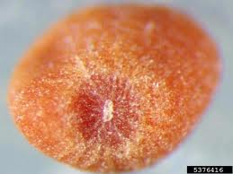
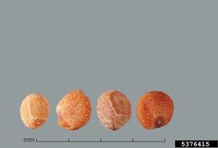
Field Dodder

Slide 25
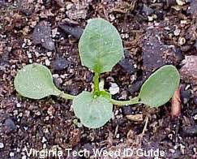
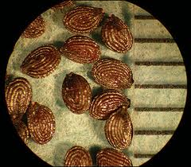
Field Pennycress

Slide 26
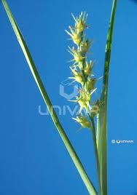
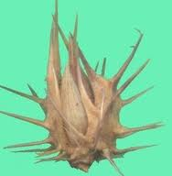
Field Sandbur

Slide 27
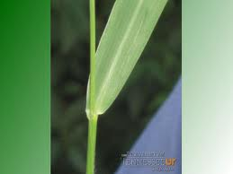
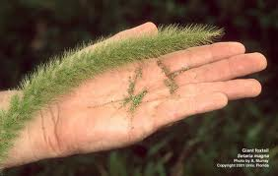
Giant Foxtail

Slide 28
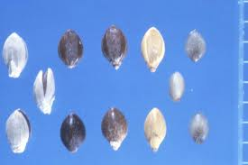
Green Foxtail

Slide 29
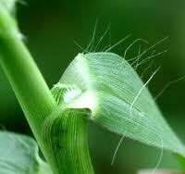
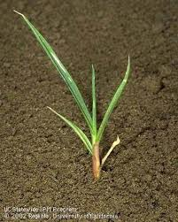
Yellow Foxtail

Slide 30
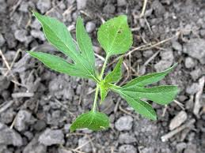
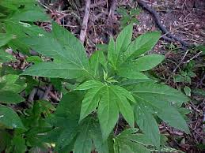
Giant Ragweed

Slide 31
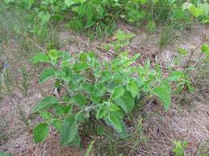
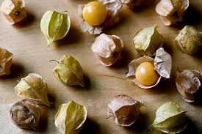
Ground Cherry

Slide 32
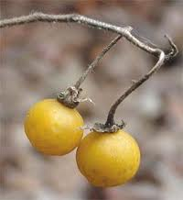
Horsenettle

Slide 33
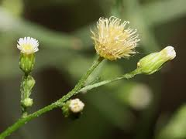
Horseweed (Marestail)

Slide 34
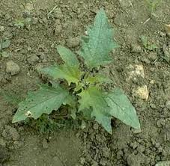
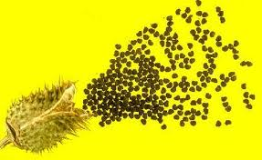
Jimsonweed

Slide 35
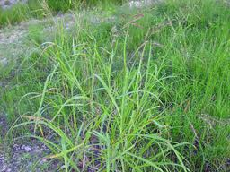
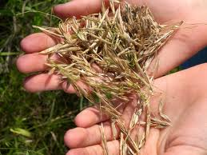
Johnsongrass

Slide 36
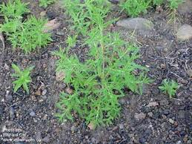
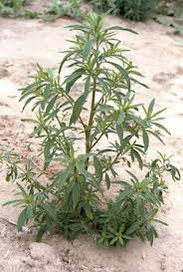
Kochia

Slide 37
Leafy Spurge

Slide 38
Morningglory

Slide 39
Silver Nightshade

Slide 40
Nutsedge

Slide 41
Prickly Lettuce

Slide 42
Prostrate Knotweed

Slide 43
Prostrate Spurge

Slide 44
Puncturevine

Slide 45
Quackgrass

Slide 46
Red Root Pigweed

Slide 47
Russian Thistle

Slide 48
Shepards Purse

Slide 49
Smartweed

Slide 50
Sow Thistle

Slide 51
Tansy Mustard

Slide 52
Velvetleaf

Slide 53
Wild Carrot

Slide 54
Wild Mustard

Slide 55
Wild Oats

Slide 56
Wild Onion/Garlic

Slide 57
Wooly Cupgrass

